Slide 1

NEXT GENERATION MEDIA PROGRAM
The Justice Beat Talk Show
The Just-Us YOUth Talk Show
“Learning while Leading”

Slide 2
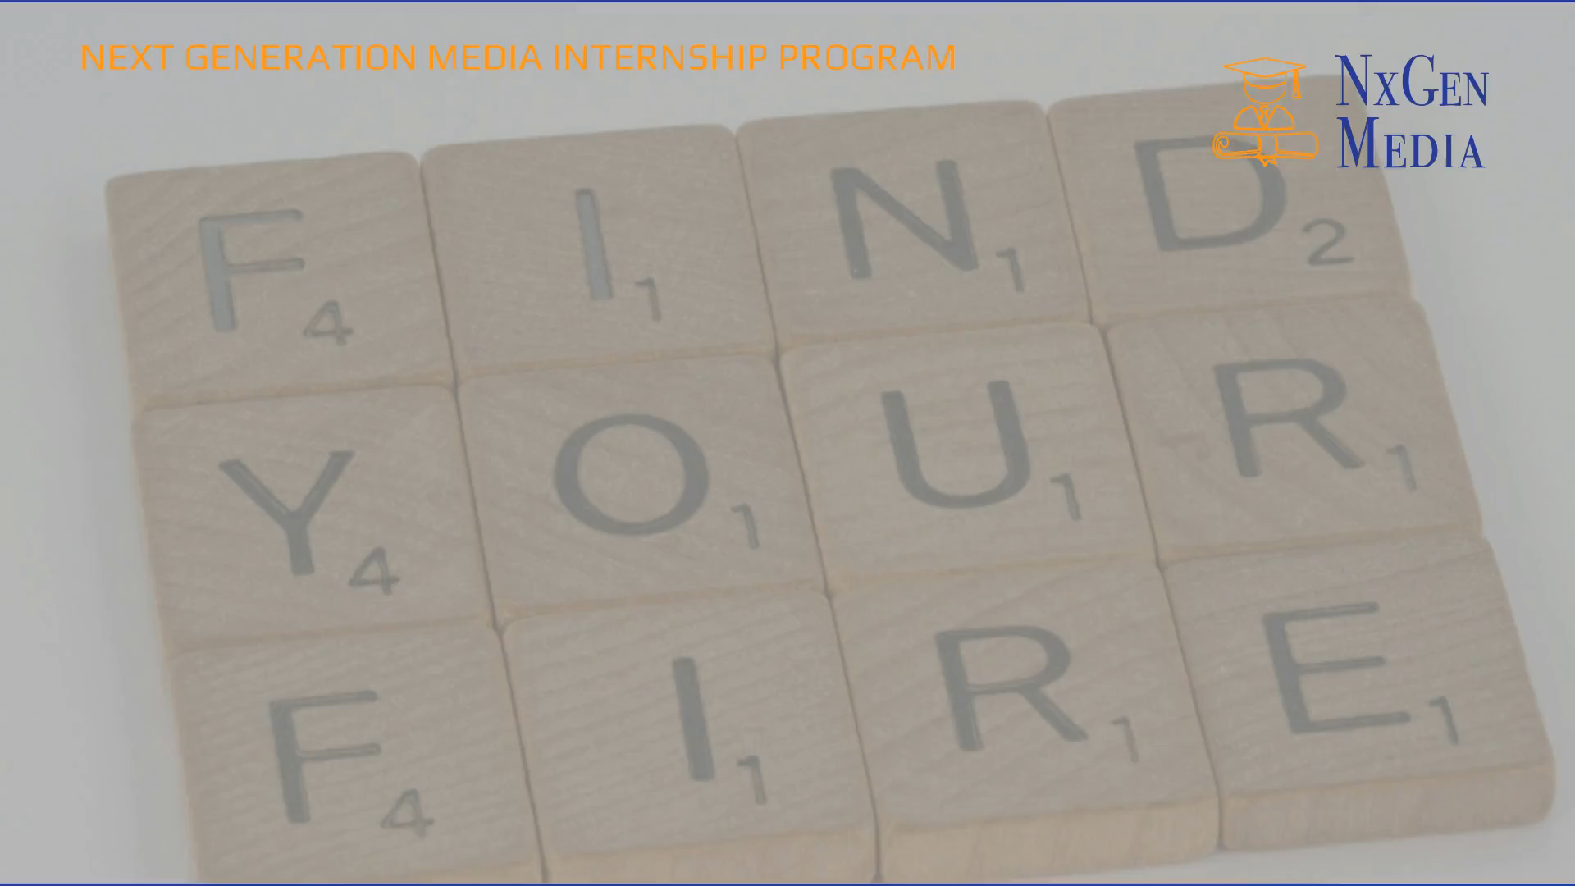
New Generation Media Internship Program
Promo Video

Slide 3
The Company:
Covenant Collaborative Consulting & Training, LLC
The Program:
Next Generation Media Internship Program
Media Apprenticeship Pathways Program
The Project:
The Justice Beat Talk Show
The Just-Us YOUth Talk Show

Slide 4
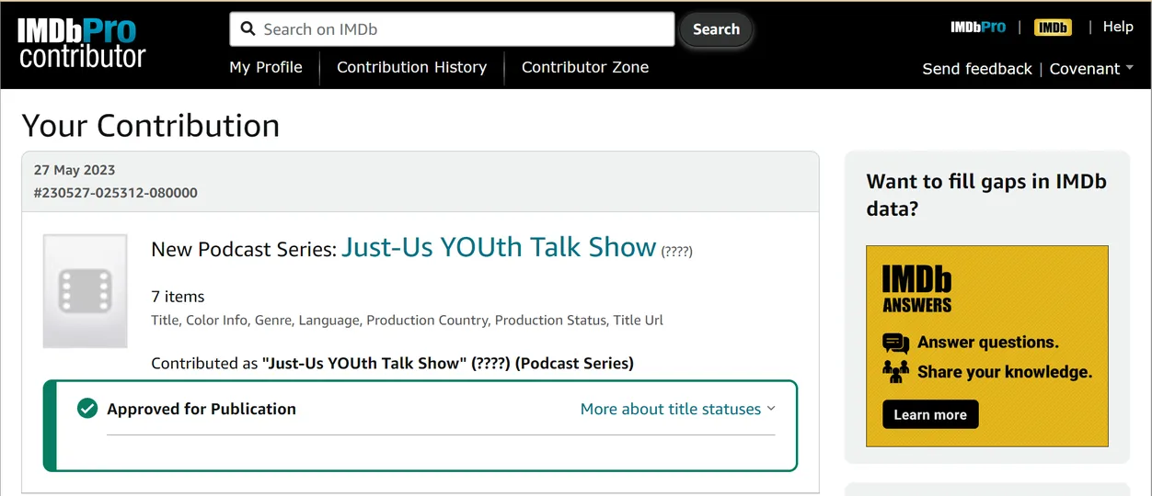
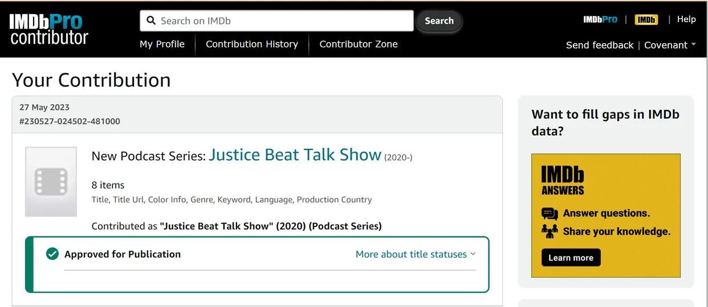
IMDb Approved for Publication

Slide 5
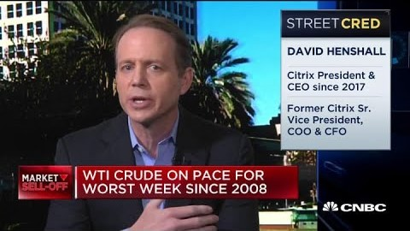
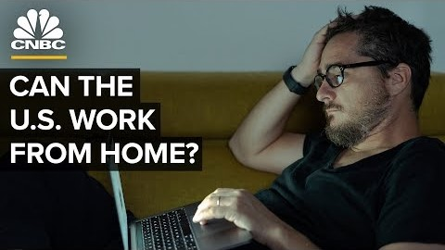
Forward Thinking of NxGen Media:
The Changing Landscape of Onsite v. Remote Working

Slide 6
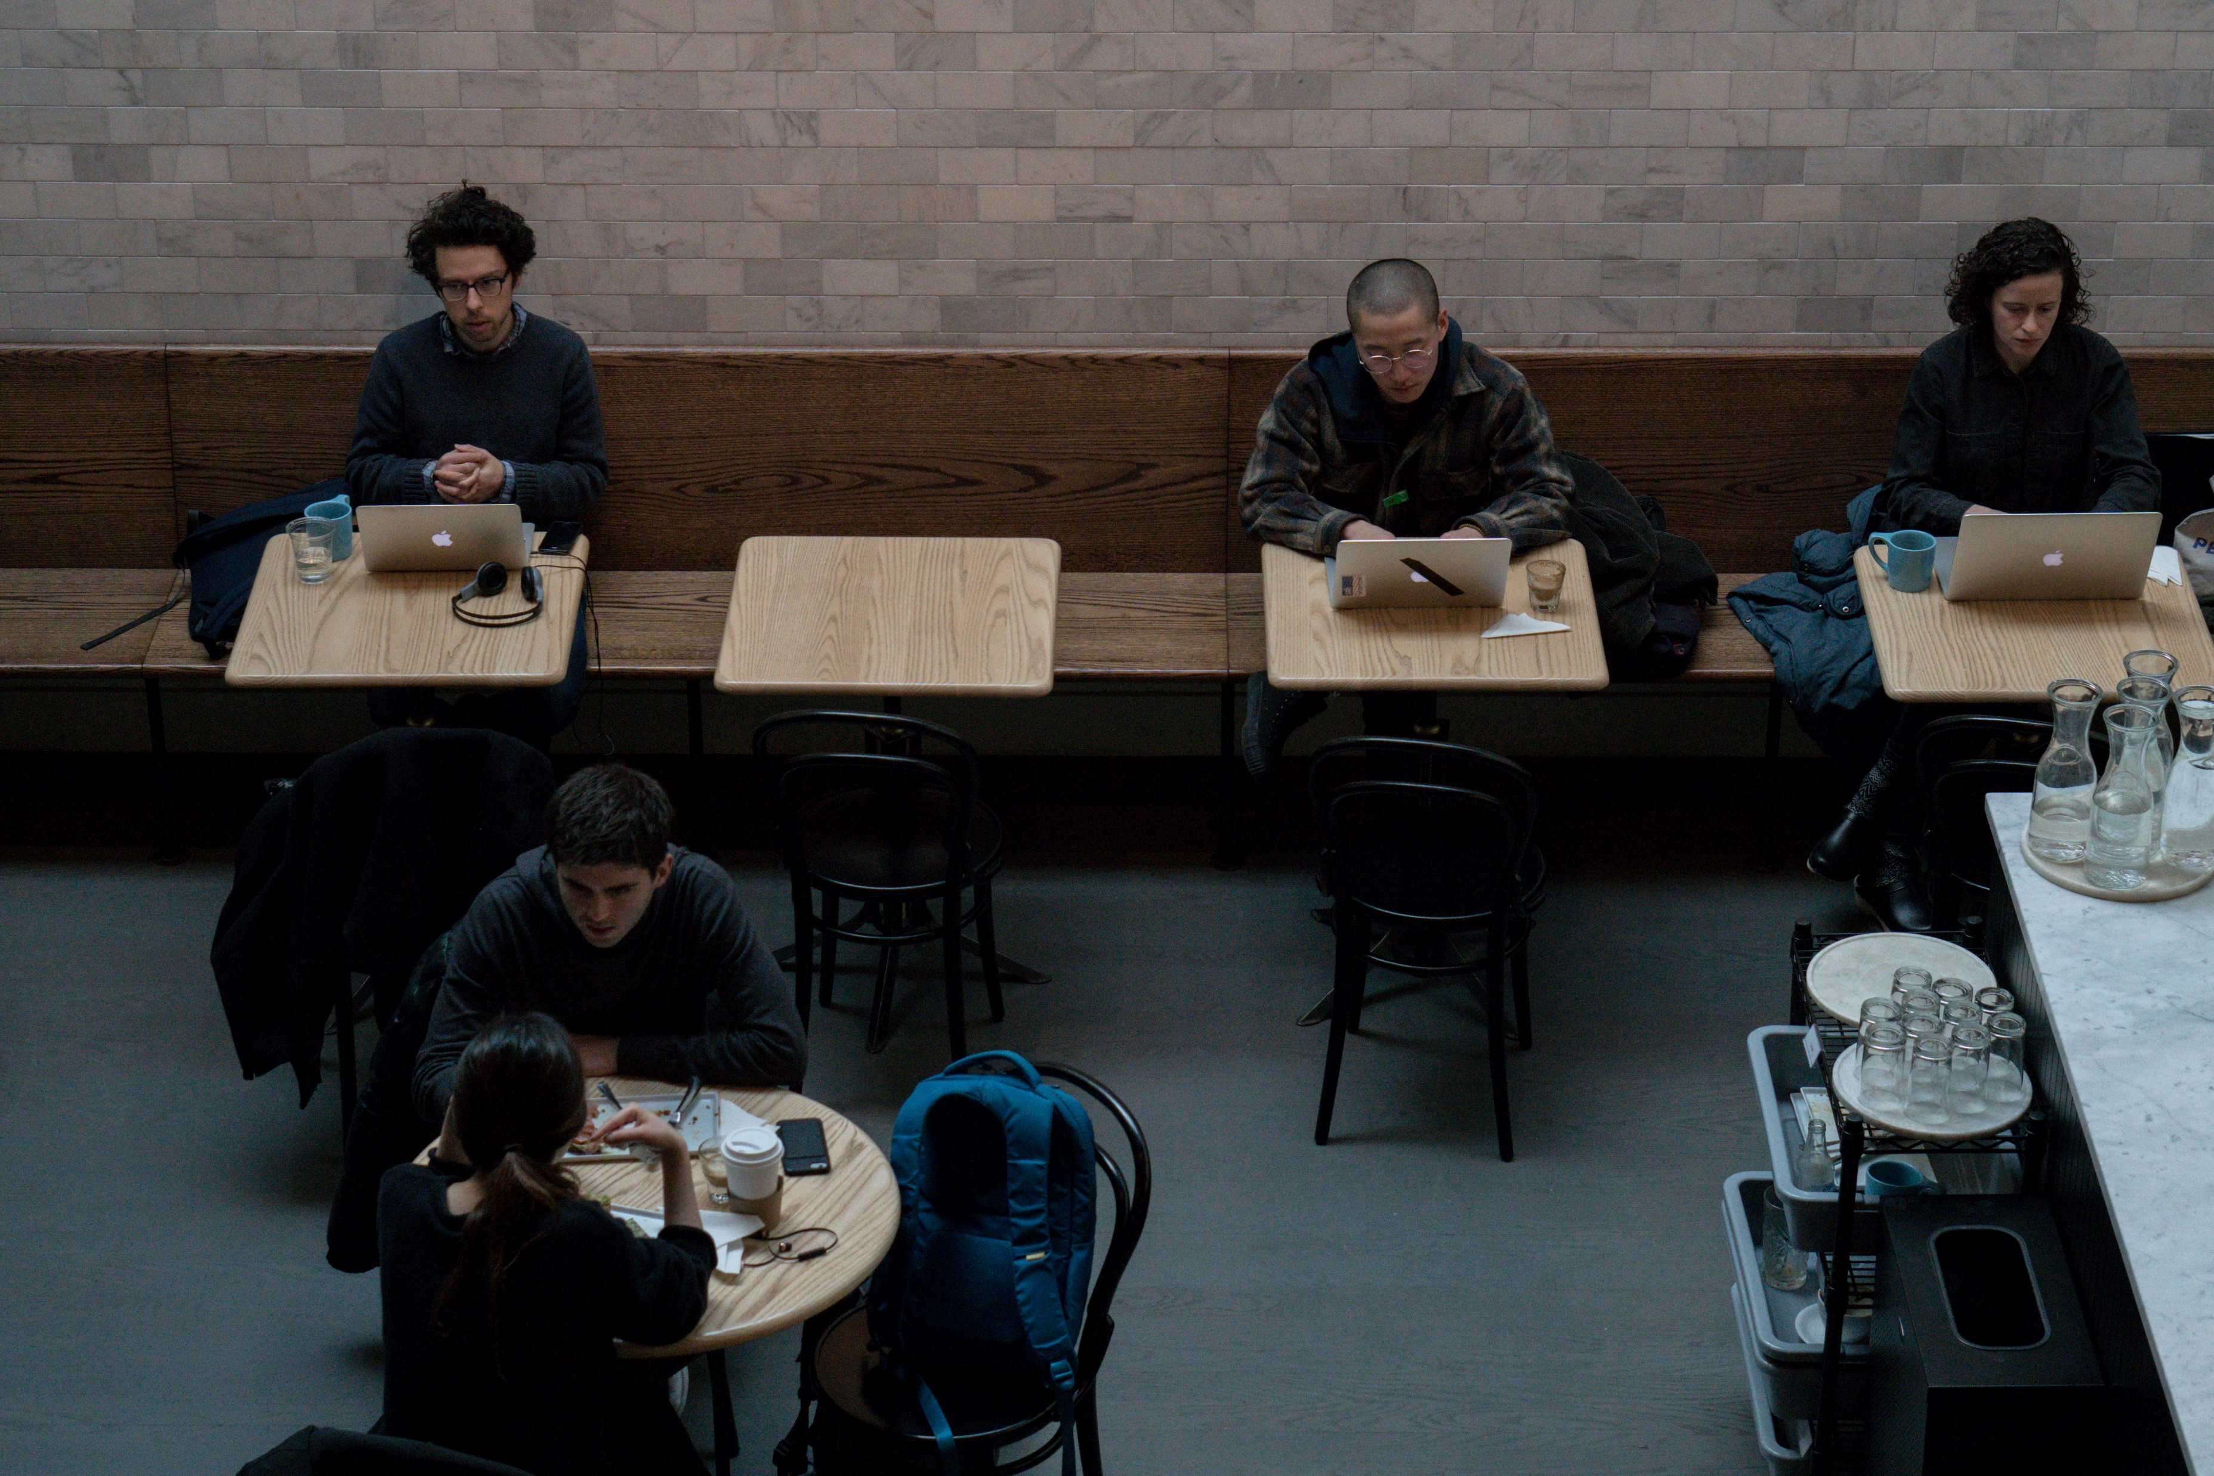
THE NEED
Advancements in technology, not to mention COVID-19, necessitates the need for the creation of alternative and sustainable development of competencies for undergraduates and the displaced by taking into account the emerging and evolving “remote” working space developing today.

Slide 7
The Case for Remote
Goal: Preparing undergraduate/graduate students and WIOA participants for the emerging and evolving marketplace
Obj. 1: Introduction to experiential learning
Obj. 2: Continuous project-based learning
Obj. 3: Instruction in the use of online remote related technology
Obj. 4: Guidance in self-governance, project, and time management
Obj. 5: Coaching in effective remote communication, teamwork, and collaboration
Obj. 6: Mentoring in managing projects efficiently using PM tools

Slide 8

NGM PROGRAM
Offered year-round and designed exclusively for undergraduate, graduate, WIOA participants/students as well as marginalized and underserved groups to obtain experiential and project-based learning in the digital broadcast and media industries with an emphasis on remote spaces.

Slide 9
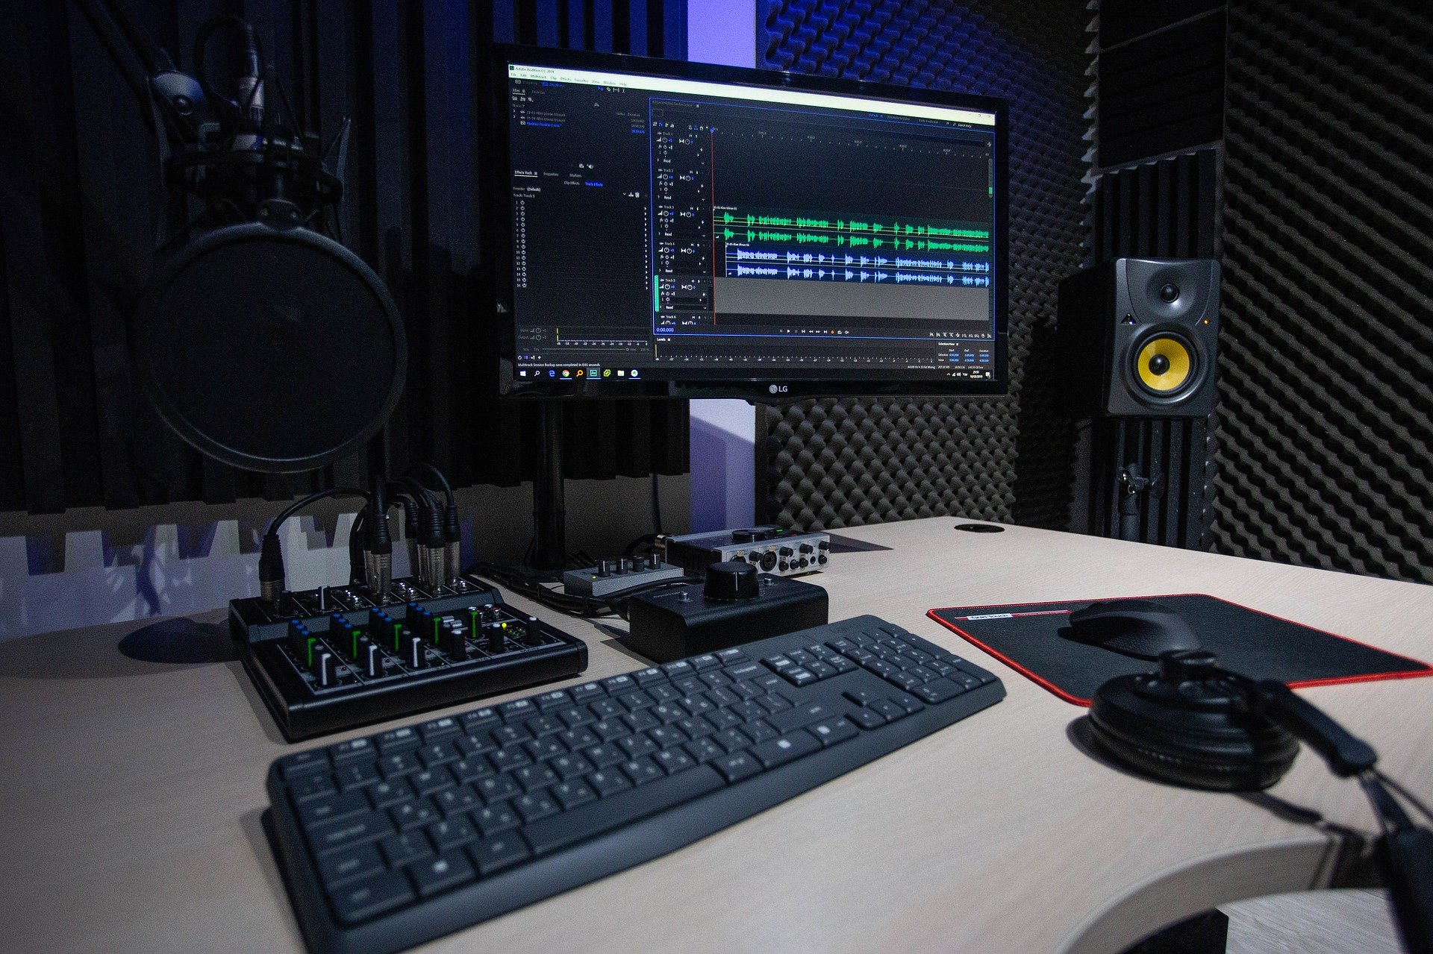
Tagline…
“Learning while Leading”

Slide 10
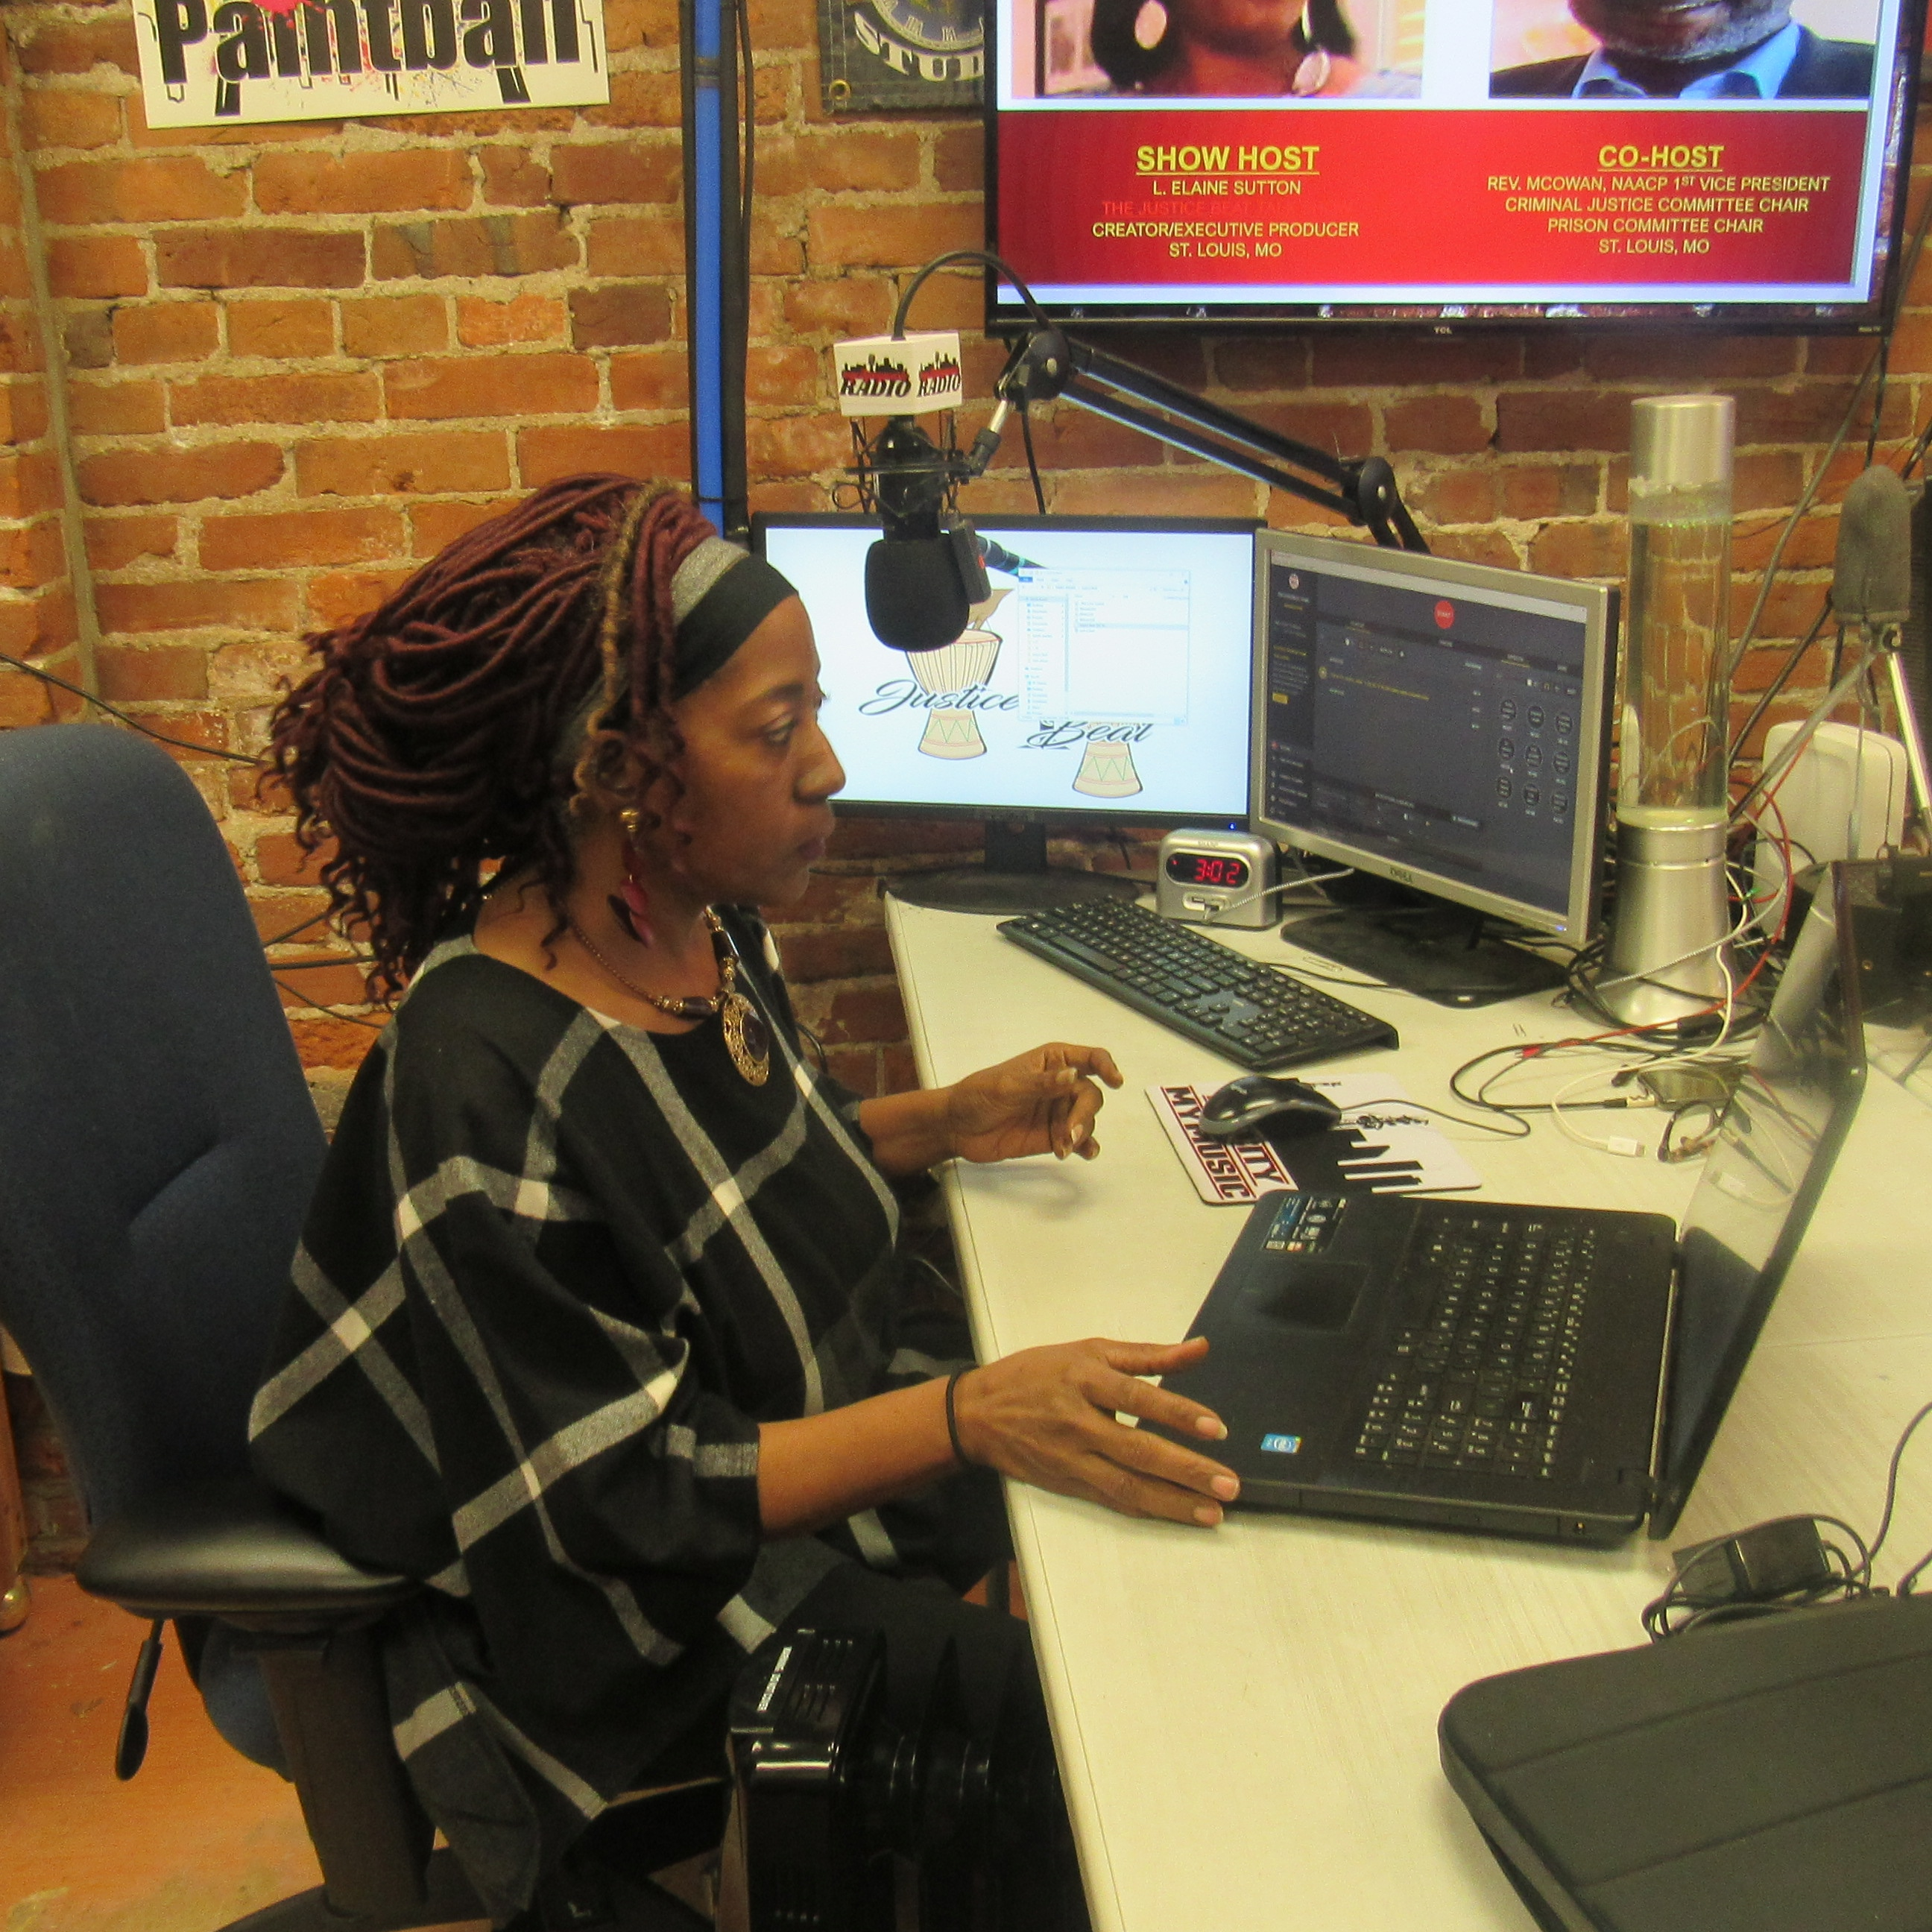


PROGRAM BENEFITS
Cross Project Collaboration
Weekly Team Debriefings
Remote/Virtual Model (Hybrid)
Hands-on Supervision & Monitoring
Teaming Arrangements

Slide 11
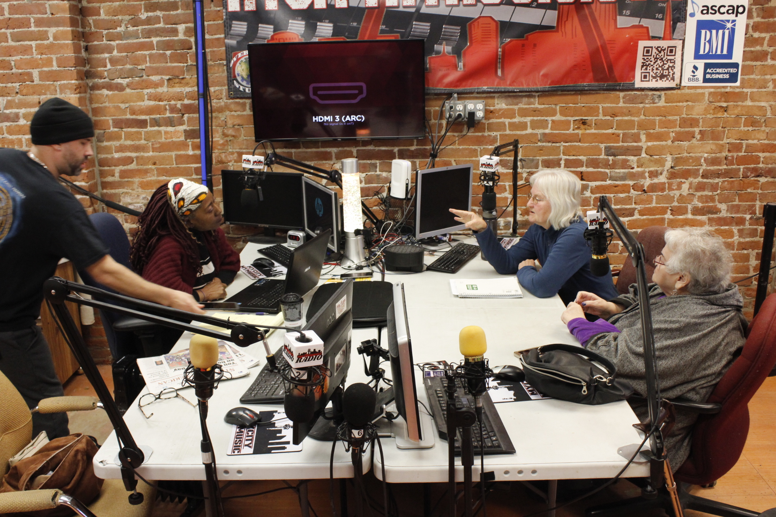
OUR SPECIALIZED OFFERINGS
Intensive Onboarding
Hands-on training
Placement across disciplines
Performance Evaluations (upon request)
Letter of Recommendation (upon request)
Certificate of Completion
Development of Body of Work (Portfolio)

Slide 12
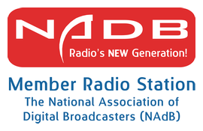
SOCIAL MEDIA PRESENCE
@justicebeat2day
Facebook
YouTube – @justicebeat2020
Twitter
Instagram (IG)
Instagram TV (IGTV)

Slide 13

The Justice Beat Talk Show:
NEXT GENERATION MEDIA
(NxGen Media Program)
Cross Discipline Impact
Production Team Roles
Valued-added Proposition
Mass Communications (TV-Radio)
Media Communication
Public Relations
Marketing and Advertising
Graphic Arts
Criminal Justice
Public Policy
Film/Videography
Journalism
Graphic Artists
Web Designer/Master
Content Creator
Production Assistant
Technical Production Assistant
Social Media Assistant
Video Digest Content Creator
Research Assistant
Marketing/Advertising Assistant
Analytics Analyst
Artificial Intelligence Strategist
Remote/VirtualHybrid Space
Project-based Learning
Integrated Learning
Experiential Learning
Internship/Practicum
Work-based Learning
Personal Portfolio Creation
Career Readiness
Exposure to Remote Work Tools
Exposure to AI Tools

Slide 14
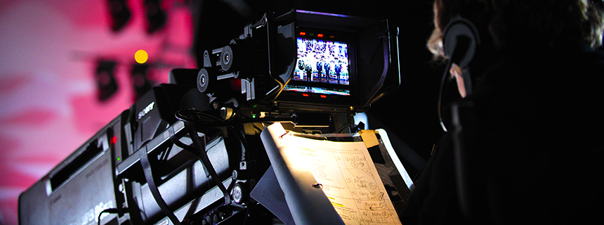
BENEFITS OF REMOTE ENVIRONMENT
FLEXIBILITY/ADAPTABILITY
COMMUNICATION (WRITTEN AND ORAL)
TEAMWORK/COLLABORATION
RESEARCH/INVESTIGATION SKILLS
REMOTE TECHNOLOGY TOOLS
TIME MANAGEMENT
SELF-MOTIVATED/GOVERNANCE
CREATIVITY/INNOVATION
PROJECT MANAGEMENT

Slide 15

Pre-Summer & Summer COMMUNICATION, MANAGEMENT, AND SUPERVISION PLAN
(Pre-Summer) Days: Negotiable days/hours (June – August)
(Academic School Year: T/TH/F/Sat (October – April)
Remote/Virtual (Hybrid)
Mandatory Weekly Debriefings/Group Supervision (Fridays at 9:30 a.m. CST)
FB: Workplace/Chat for submission of project assignments for review (remote collaboration space for teams)
Use of Trello (project management tool) for building out weekly podcast episodes
One-on-One Video-conferencing via Zoom (provide project specific direction/guidance and Q&A)

Slide 16

Year-round Schedule
Summer Months (June – August)
Dedicated to repurposing of live content and prepping for upcoming season (Post-production work)
Content development for SoundCloud and YouTube Channel (video/audio)
Fall Season (October - December)
Pre-production Planning for Live Season
Recruitment (August/September) and Onboarding (October) for Fall Season
Winter (January – Annual Show Anniversary Celebration on MLK Holiday – Live-show)
Winter/Spring Season (February – April)
Live-taping of current season episodes (12 episodes)
Production Vacation Schedule
Thanksgiving Week (Saturday following Thanksgiving – NO SHOW)
Christmas Break (Last live show 2 weeks before Christmas)

Slide 17

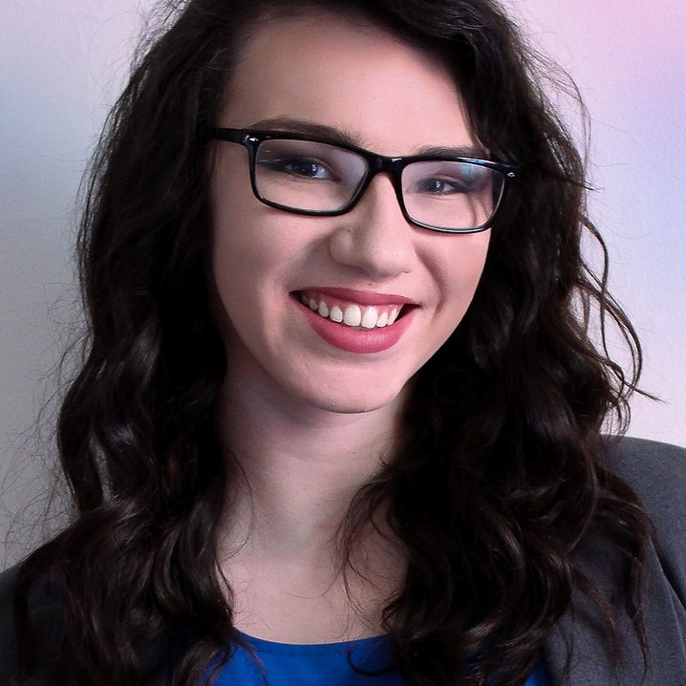
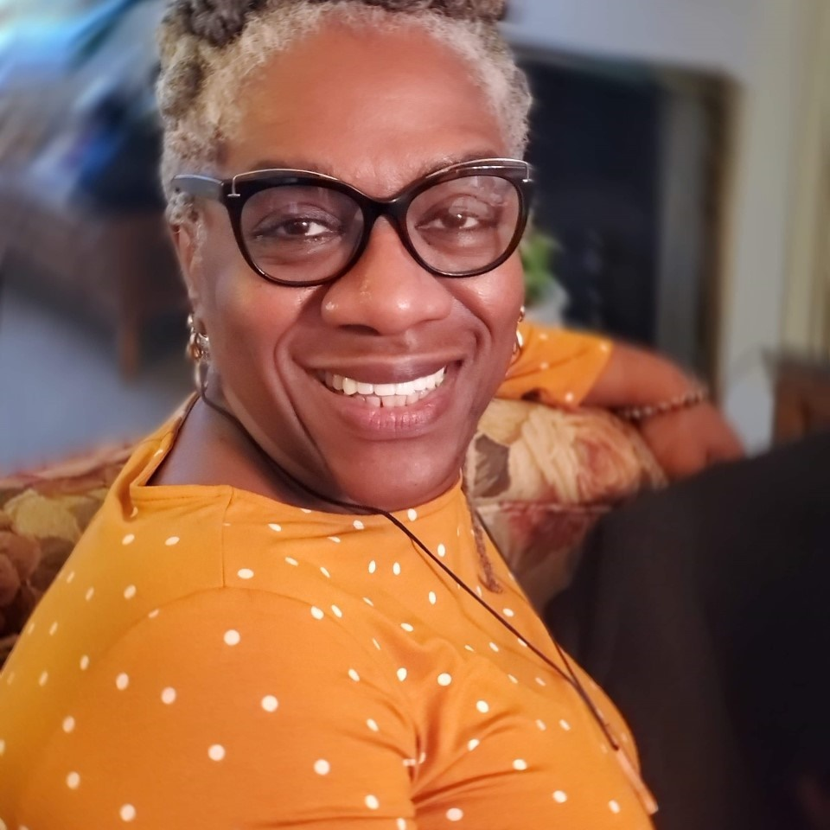
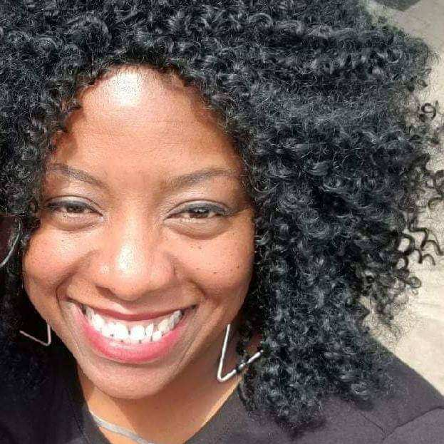
Executive Team
L. Elaine Sutton Mbionwu, CCHP, PMP
The Justice Beat Talk Show
Executive Producer/Host/Internship Director
Renn Spigelmyer
Director of Branding & Marketing and Project Supervisor
Karla S. McKinney, M.Ed.
Just-Us YOUth Talk Show
Sr. Assoc. Producer/Host/Project Supervisor
Clinical Show Consultant – Karen D. Sutton, LCSW

Slide 18

Membership and Collaborative Partnerships

Slide 19



CONTACT
L. Elaine Sutton Mbionwu
producer@thejusticebeat.com

